Slide 1
CellRanker
An R Framework For Rank-Based Cell Type Annotations On scRNA-Seq Data
Alicia Petrany
Rowan University
Profhacks 2023

Slide 2
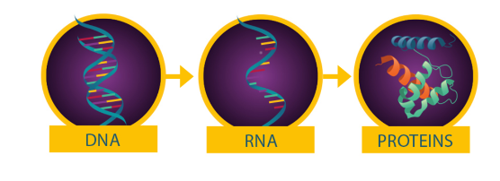

What is scRNA-Seq?
 | Cell₁ | Cell₂ | Cell… | Cell_{j}
Gene₁ | … | … | … | …
Gene₂ | … | … | … | …
Gene… | … | … | … | …
Gene_{i} | … | … | … | …
Cell types of heterogenous samples are unknown – they must be manually determined
Counting
Transcriptome

Slide 3
CellRanker Workflow
Data Preprocessing (Filtering, Normalization, Scaling, tSNE Cordinate Generation, Clustering)
Marker Gene Classification For Each Cluster
Querying PangaoDB For Marker Gene Annotations
Calculating Rankings For Each Potential Cell Type For Each Cluster
Visualize tSNE Embeddings With Appropriate Cell Type Lables

Slide 4
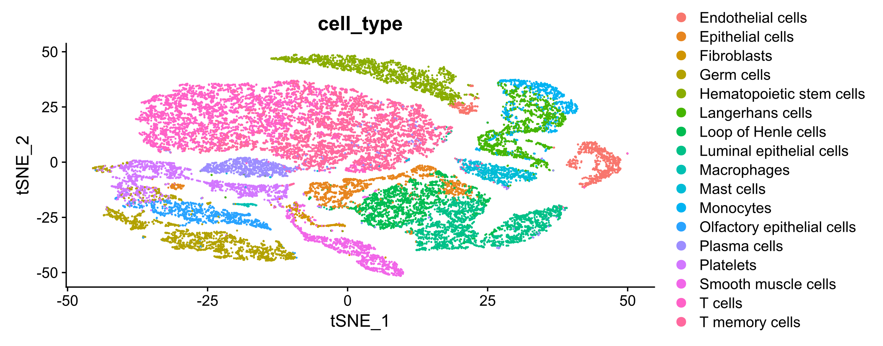
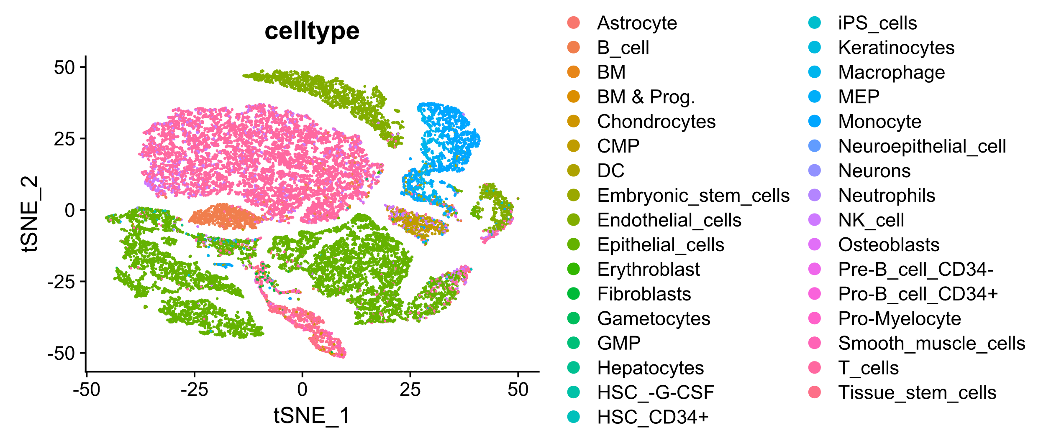
Results – R Package
CellRanker
SingleR

Slide 5
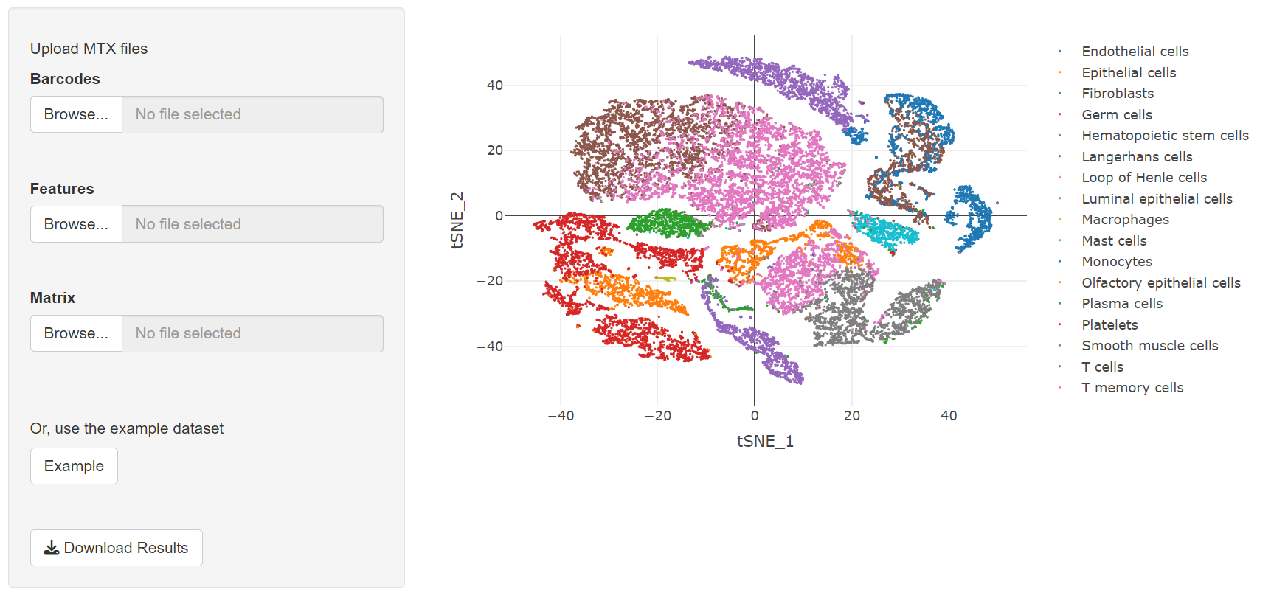
R Shiny Application
https://av33d2-alicia-petrany.shinyapps.io/cellranker/

Slide 6
Questions?

